Slide 1
The PID Controller

Slide 2
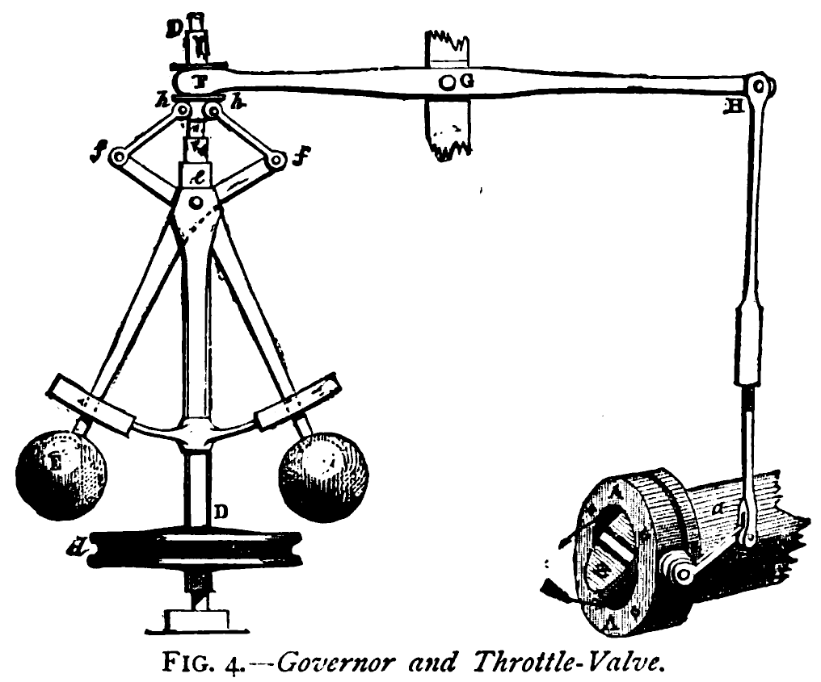
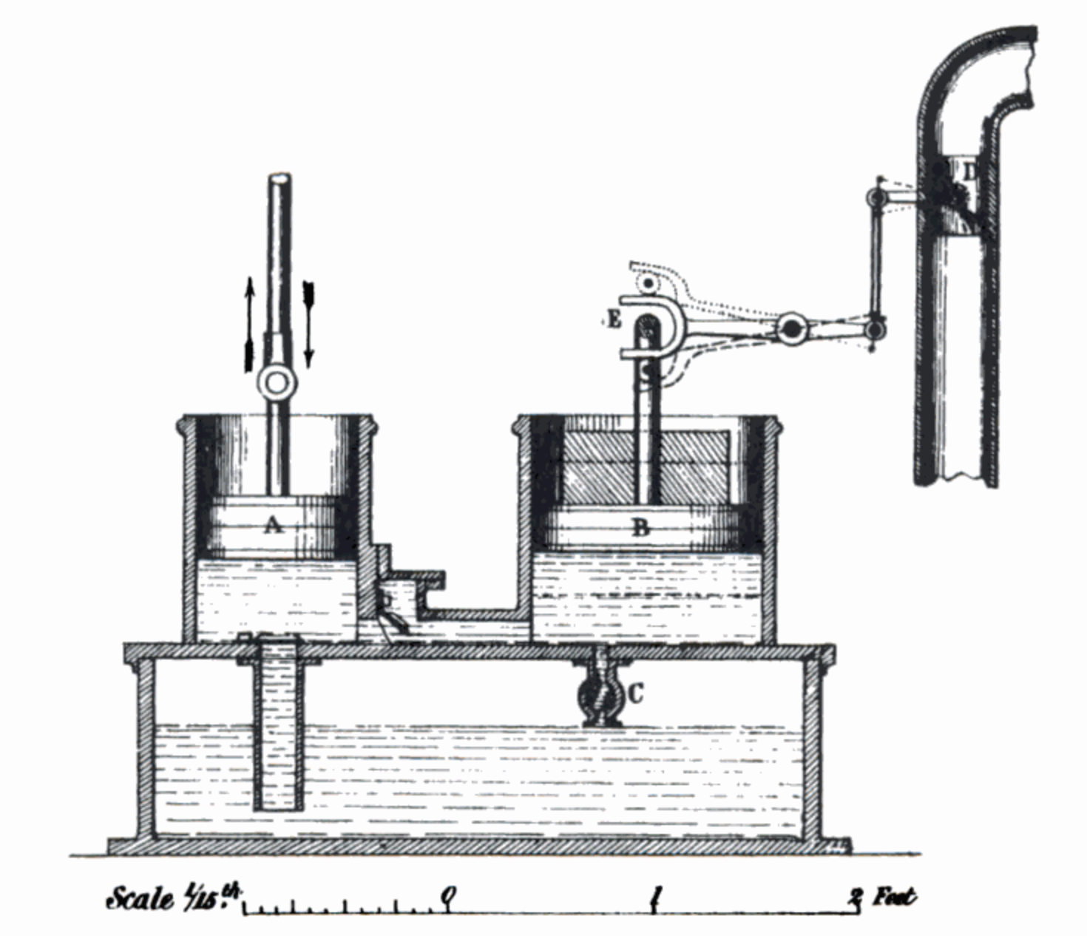
What is PID?
Make a system follow a set point
“Proportional, Integral, Derivative”
A brief history:
1788 - James Watt’s flyball governor (P)
1837 - Louis Molinié hydraulic regulator (PI)
1857 - H.N. Throop marine engine governor (PD)
1868 - Maxwell gives theoretical basis
1911 - Elmer Sperry, ship steering (PID)

Slide 3
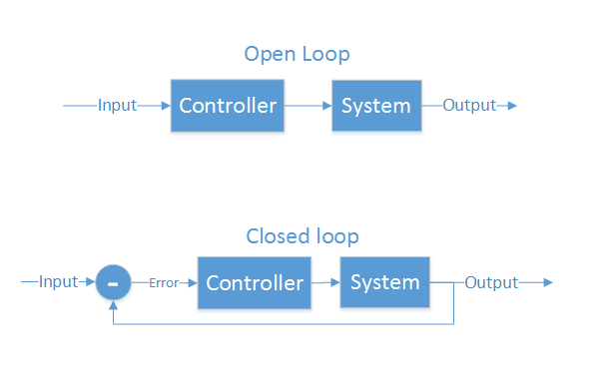
Control Theory
Making a physical system do what you want
“Open loop” and “closed loop”
Open loop - cannot see the system’s output
Motor controllers
LCD/LED/CRT screens
Some ICBMs
Closed loop - Can see output, make corrections
Autopilot
GPS guided munitions
Our quadcopter

Slide 4
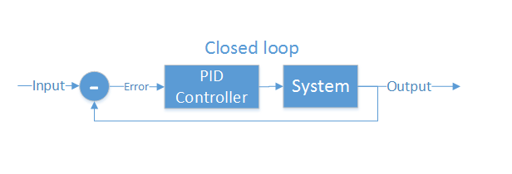
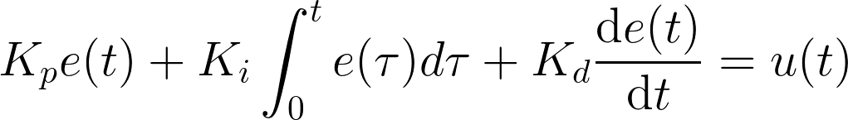
Closed loop control
PID is the most common closed loop controller
Proportional: Directly against error
Integral: Remembers error over time
Derivative: Dampens response to avoid oscillations

Slide 5
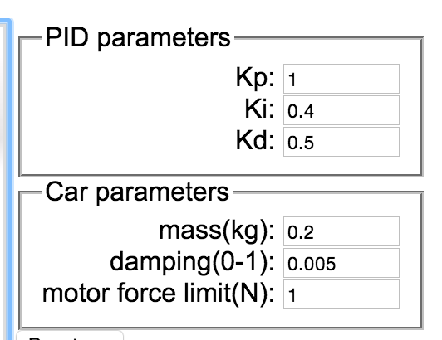
Example
https://sites.google.com/site/fpgaandco/pid

Slide 6
PID on the Quadcopter
3 separate controllers
PID set point is from user

Slide 7
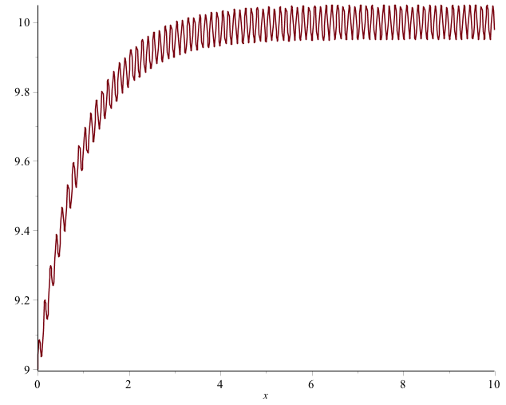
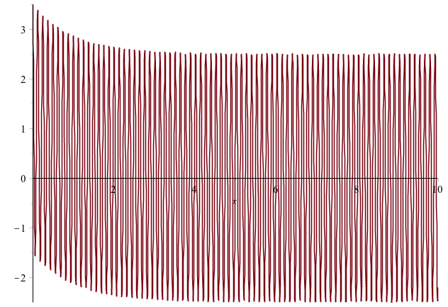

Pitfalls of PID
Integral term “Windup”
One solution: turn it off unless we’re close
Derivative noise: beware of vibrations
Error term with vibration
Derivative term causes your system to go insane
Solution: low pass (but not too much)
3. Tweaking PID values
Know more about the system (auto tuners do this)

Slide 8
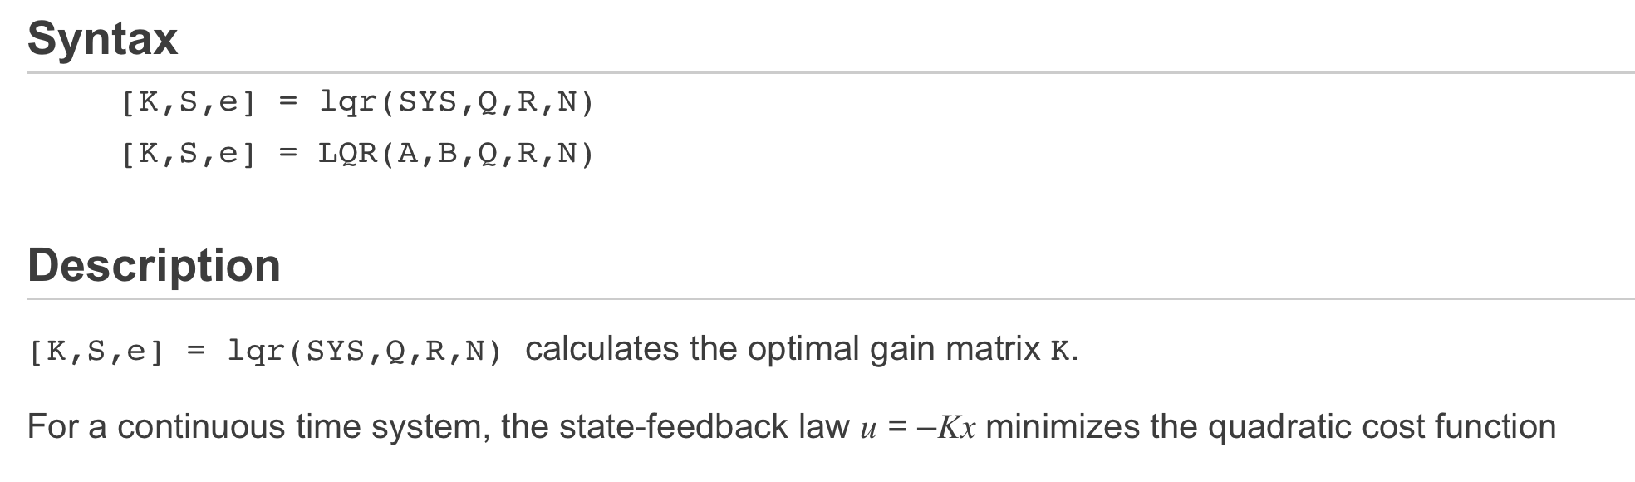
Better than PID?
Better tweaking of parameters
Knowing the whole transfer function helps
LQR (Linear Quadratic Regulator)
Optimizes parameters for multiple outputs
Available in Maple, MATLAB
But you have to know the system’s equations

Slide 9
Questions

